Slide 1






Basic Details of the Team and Problem Statement
PS ID: T3PSO2
Problem Statement Title: AI DRIVEN ENERGY MANAGEMENT PLATFORMS
IDEA TITLE: IMPROVING POWER FACTOR BY AI AND ML IN INDUSTRIES
Team Name: THUNDERS
Team Leader Name: PRAKASHRAJ M
Institute Name: COIMBATORE INSTITUTE OF TECHNOLOGY (CIT)

Slide 2
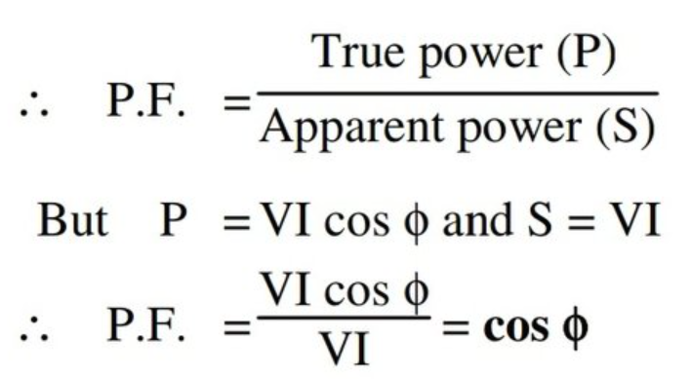
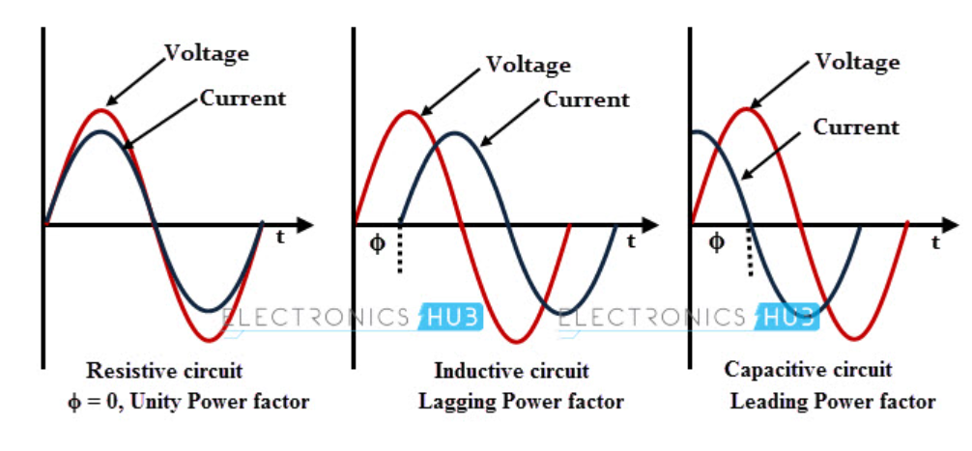
POWER FACTOR:
The cosine of the phase difference between voltage and current is known as the power factor.
Power Factor = cosɸ
where ɸ denotes the phase difference between the current phasor and voltage

Slide 3
IMPACTS OF LOW POWER FACTOR:
Increased Power Losses
Increased Electricity Costs
Reduced System Efficiency
Decreased Lifespan of Electrical Equipment
Voltage Regulation Problems
OUR PRESENTED IDEA IS TO IMPLEMENT AI TO CONTINUOUSLY DETECT AND MONITOR POWER FACTOR AND INCREASE IT BY CAPACITOR BANKS.

Slide 4
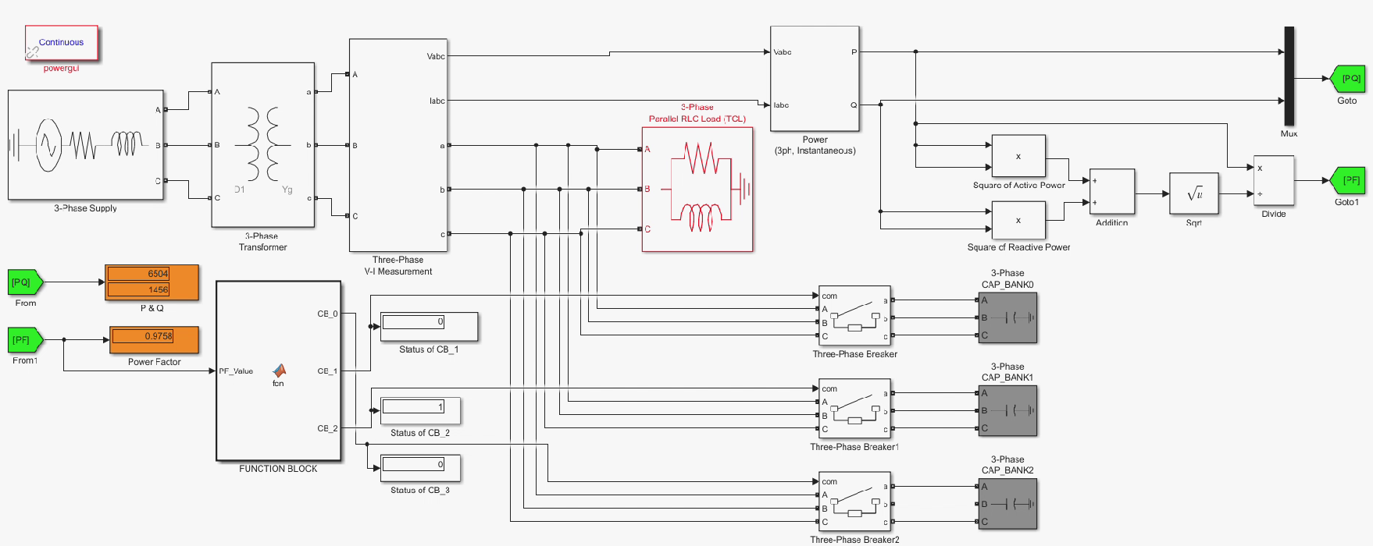
SIMULATION:
0 = CAPACITOR BANK CIRCUIT OPEN (OFF)
1 = CAPACITOR BANK CIRCUIT CLOSED (ON)

Slide 5
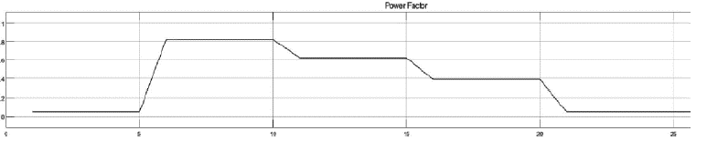
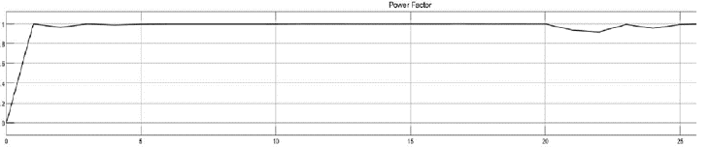
COMPARISON OF GRAPHS OF POWER FACTOR WITHOUT AND WITH CAPACITOR BANKS:

Slide 6
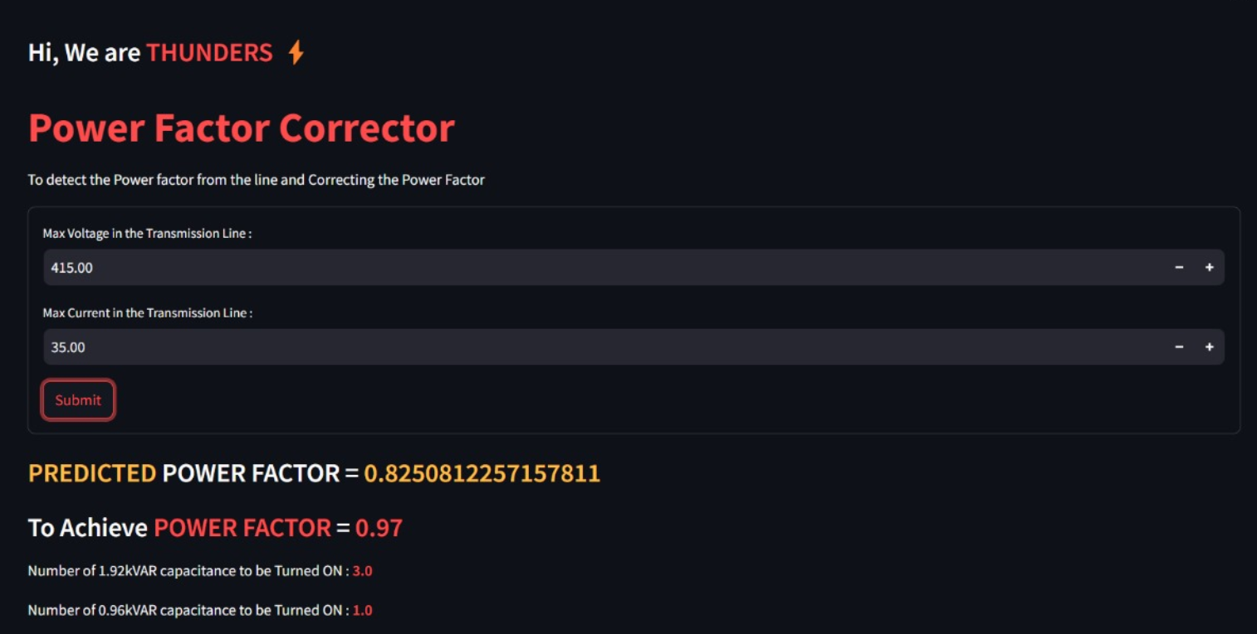
PREDICTING POWER FACTOR USING MACHINE LEARNING:

Slide 7
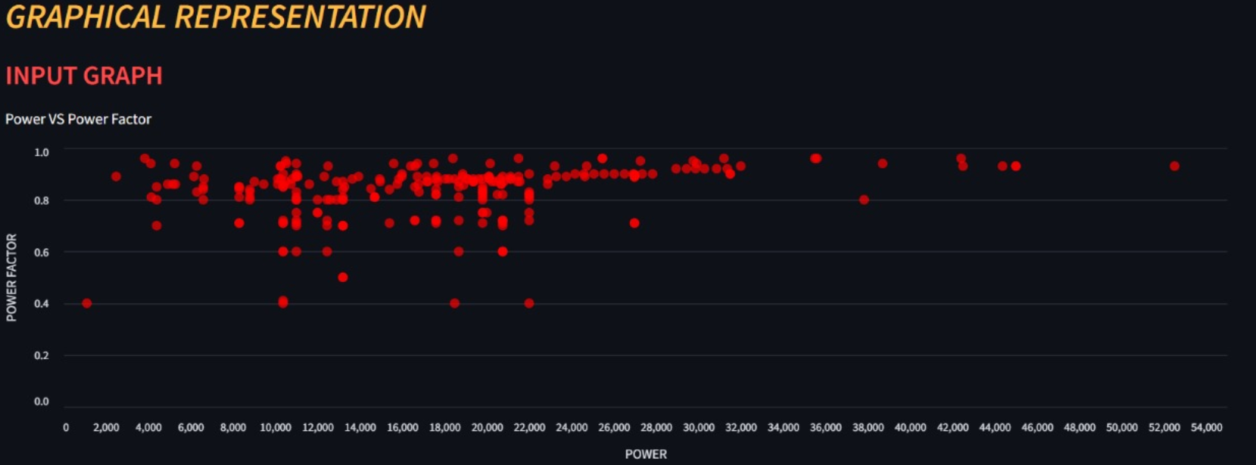

Slide 8
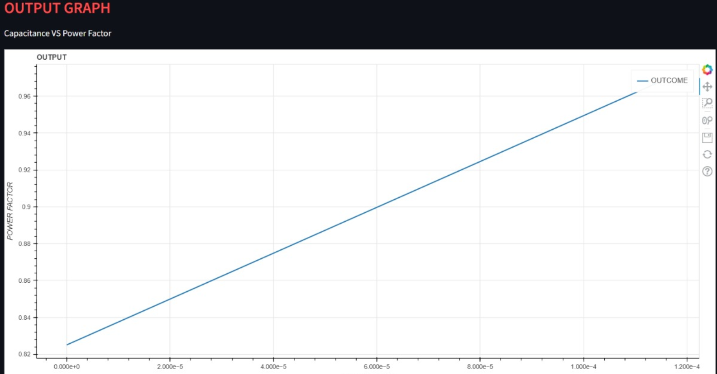

Slide 9

INFERENCE:
CONSIDER INPUT VOLTAGE SUPPLY LINE : 415V
CONSIDER INPUT CURRENT : 30A
POWER FACTOR | CAPACITANCE TO BE ADDED (IN KVAR)
0.5 | 19.2
0.6 | 14.4
0.7 | 9.6
0.8 | 6.72
0.9 | 3.84
0.97 | 0.0

Slide 10
ADAVANTAGES OVER EXISTING SOLUTIONS:
Continuous Monitoring and Optimization
Predictive Maintenance
Enhanced Decision-Making
ENERGY MANAGEMENT:
Increased System Efficiency
Reduced Power Losses: A high power factor means that the current flowing through the system is minimized for a given amount of real power (kW). This reduces resistive losses in conductors (I²R losses), improving the overall efficiency of the electrical system.

Slide 11
EXAMPLE:
Assume a indutry using power of 350kW including both reactive and real power and getting bill of ₹4,55,000 as bill for power factor of 0.8.Let us find same bill amount for power factor of 0.97
Apparent power(S)(for PF=0.8) = 350K/0.8 = 437.5KVAR
New apparent power (S’) (for PF=0.97) = 350K/0.97 = 360.82KVAR
Initial cost per KVAR = 455000/437.5KVAR = ₹1040 per KVAR
Cost(PF=0.97) = 360.82KVAR*1040 per KVAR = ₹3,75,252.8
SAVINGS :
= ₹(4,55,000-3,75,252) = ₹79,748
In % = 79,748/4,55,000 * 100% = 17.5%
Thus by increasing the power factor to 0.97 from 0.8 gives approximately 18% cost reduction in bill amount and power used is also reduced.

Slide 12
Team Member Details
Team Leader Name: PRAKASHRAJ M
Branch: EEE Stream: ENGINEERING Year: 2024
Team Member 1 Name: PRANAV SANJAY S
Branch:EEE Stream:ENGINEERING Year: 2024
Team Member 2 Name: RANJITH KUMAR V
Branch:EEE Stream:ENGINEERING Year: 2024
Team Member 3 Name: NANDHAKISHORE J
Branch: EEE Stream: ENGINEERING Year: 2024

